Slide 1

Object Oriented Design & Programming (21CSC101T)
Arvind Kharwal

Slide 2
Deployment Diagram

Slide 3
Deployment Diagram is a type of diagram that specifies the physical hardware on which the software system will execute. It also determines how the software is deployed on the underlying hardware. It maps software pieces of a system to the device that is going to execute it.
The deployment diagram maps the software architecture created in design to the physical system architecture that executes it. In distributed systems, it models the distribution of the software across the physical nodes.

Slide 4
The software systems are manifested using various artifacts, and then they are mapped to the execution environment that is going to execute the software such as nodes. Many nodes are involved in the deployment diagram; hence, the relation between them is represented using communication paths.

Slide 5
Purpose of a deployment diagram

Slide 6
Deployment diagrams are used with the sole purpose of describing how software is deployed into the hardware system. It visualizes how software interacts with the hardware to execute the complete functionality. It is used to describe software-to-hardware interaction and vice versa.

Slide 7
Deployment Diagram Symbol and notations

Slide 8
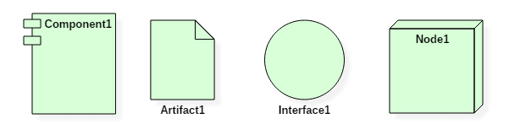

Slide 9
What is an artifact?

Slide 10
An artifact represents the specification of a concrete real-world entity related to software development. Artifacts are deployed on the nodes. Artifacts are deployed on the nodes. The most common artifacts are as follows,
Source files
Executable files
Database tables
Scripts
DLL files
User manuals or documentation
Output files

Slide 11
What is a node?

Slide 12
Node is a computational resource upon which artifacts are deployed for execution. A node is a physical thing that can execute one or more artifacts. A node may vary in its size depending upon the size of the project.
Node is an essential UML element that describes the execution of code and the communication between various entities of a system. It is denoted by a 3D box with the node name written inside of it. Nodes help to convey the hardware which is used to deploy the software.
An association between nodes represents a communication path from which information is exchanged in any direction.

Slide 13
Example

Slide 14
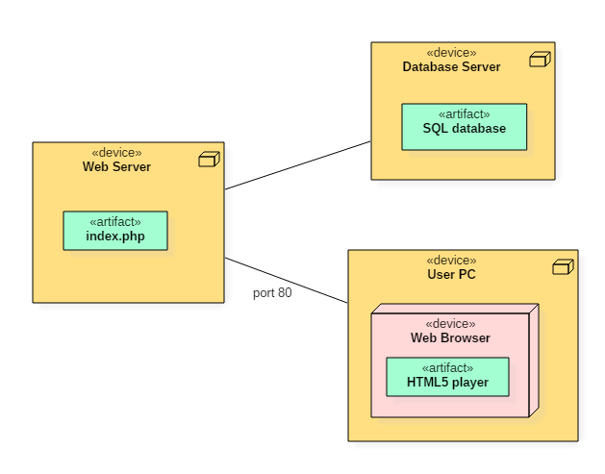

Slide 15
Thank You

